Slide 1
Section 6.1
Probabilities with Tree Diagrams and Tables
© Copyright all rights reserved to Homework depot: www.BCMath.ca

Slide 2
What is probability?
Probability - the likelihood or chance that an event will occur, ranging from zero to one (100%)
A probability of zero means that it will never occur
A probability of one or 100% means that it must occur
A probability of 0.5 means that it has a 50% of happening
Can’t have a negative probability or anything greater than one
Formula for calculating Probability
  P(A) – the probability that event “A” will occur
© Copyright all rights reserved to Homework depot: www.BCMath.ca

Slide 3
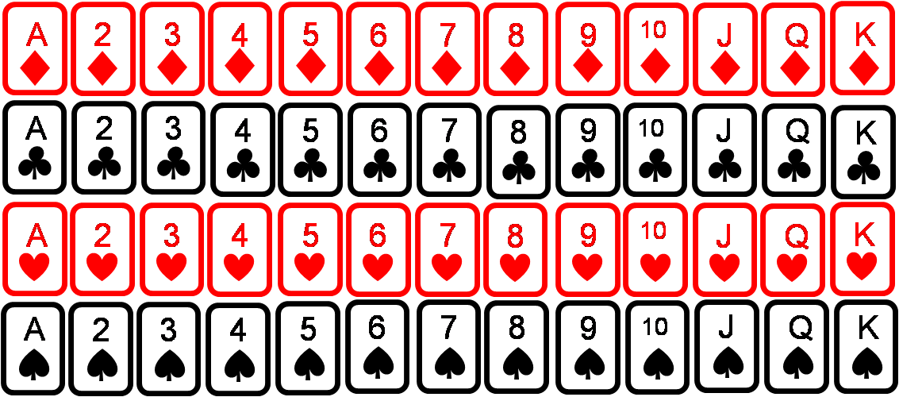
What is a sample space?
A sample space is a list of all the possible outcomes from an experiment
Ex: Find the sample space for each of the following experiments:
Flip a coin
Roll a dice
Picking a card from a deck
A letter is chosen from the word:
CHICAGO BULLS
© Copyright all rights reserved to Homework depot: www.BCMath.ca

Slide 4
Probability with Tree Diagrams:
A tree diagram can be used to illustrate all the ways an experiment can be occur
Each branch is a particular outcome
For instance, when we flip a coin the outcomes can be illustrated as:
Now suppose we flip two coins, the tree diagram will be:
1 Coin:
2 Coins
Heads
Tails
Heads
Tails
There are two cases
heads or tails
Heads
Tails
Heads
Tails
There are four cases heads or tails
HH, HT, TH, and TT

Slide 5
Practice: Suppose you flip a coin and then roll a die. Draw a tree diagram to illustrate this experiment:
b) Suppose you roll a die. If it is even, you flip a coin. If it is odd, you roll the die again. Draw a tree diagram:
1st Coin:
1st Die
2,4, 6
1, 3, 5
Heads
Tails
Heads
Tails
1
2
3
4
5
6
1
2
3
4
5
6
1
2
3
4
5
6
There are 12 cases altogether
There are 24 cases altogether
H1, H2, H3, H4, H5, and H6
2H, 2T, 4H, 4T, 6H, 6T
T1, T2, T3, T4, T5, and T6
1: 1 to 6, 3: 1 to 6, 5: 1 to 6
© Copyright all rights reserved to Homework depot: www.BCMath.ca

Slide 6
Rolling Dices:
Game: Roll two dice and take the sum. Your choices will be numbers from 2 to 12. Which sum will be appear the most?
When dealing with dice problems, it’s best to make a dice chart:
Dice #1
There are 36 different
Outcomes!
The dice chart can be used to find out which outcomes would appear the most and which ones will be the least
Dice #2
© Copyright all rights reserved to Homework depot: www.BCMath.ca

Slide 7
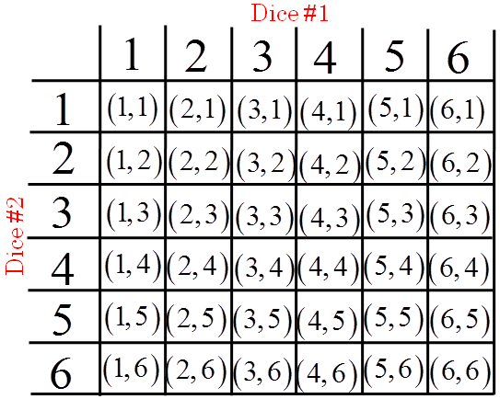
Practice: Find the probability of rolling two dice and getting each sum in the brackets:
You can’t
get a sum
of zero!!
Lucky
seven!
© Copyright all rights reserved to Homework depot: www.BCMath.ca

Slide 8
Homework:
P417 #3 to 10, and 12
© Copyright all rights reserved to Homework depot: www.BCMath.ca

Slide 9
